Slide 1
VECTOR INTEGRATION
By Dr.Sushma
Assistant Prof.
Department of Mathematics,
Kanya Mahavidyalaya, Kharkhoda

Slide 2
VECTOR INTEGRATION
Introduction
The vector integration is used to model mathematically vast range of engineering phenomena including electrostatics, electromagnetic fields etc.
Objective
After going through this presentation, we will be able to find the vector integration i.e. indefinite and definite integral. The purpose of this chapter is also to learn line integral, surface integral and volume integral for vector function.

Slide 3
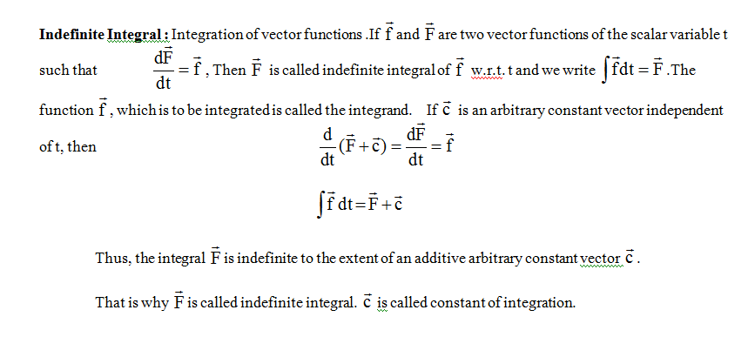
Indefinite intetegral

Slide 4
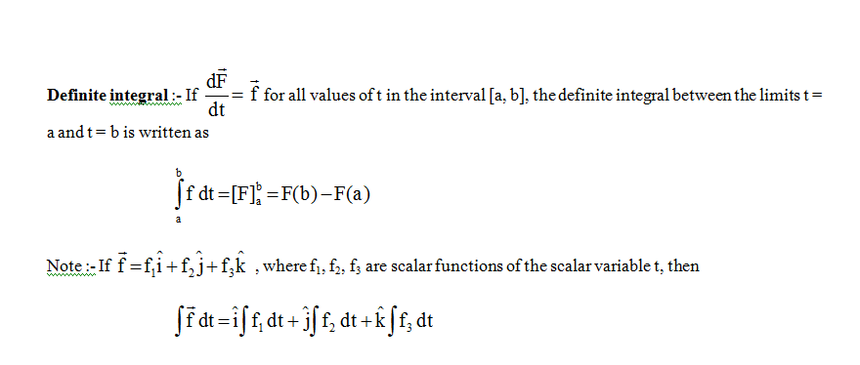
Definite integral

Slide 5
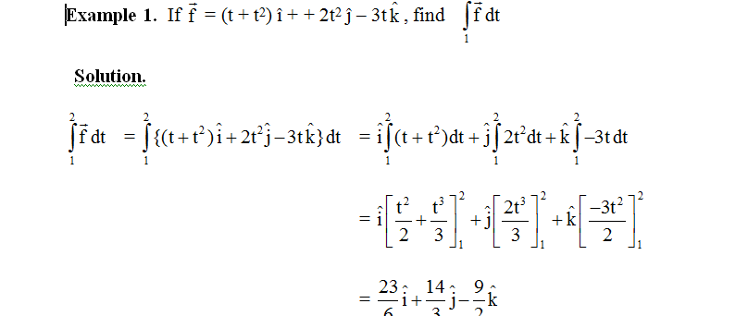

Slide 6
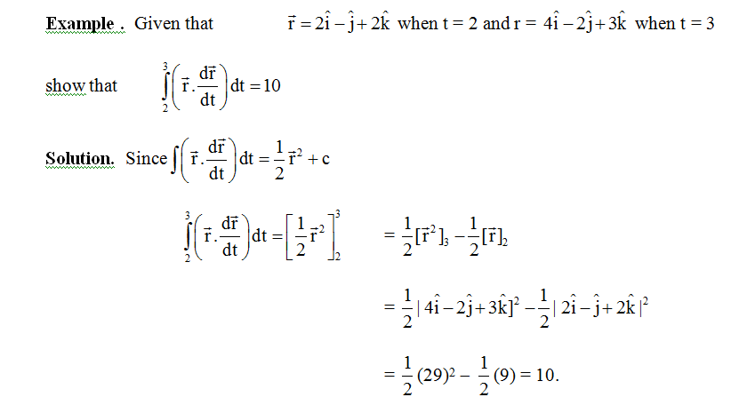

Slide 7
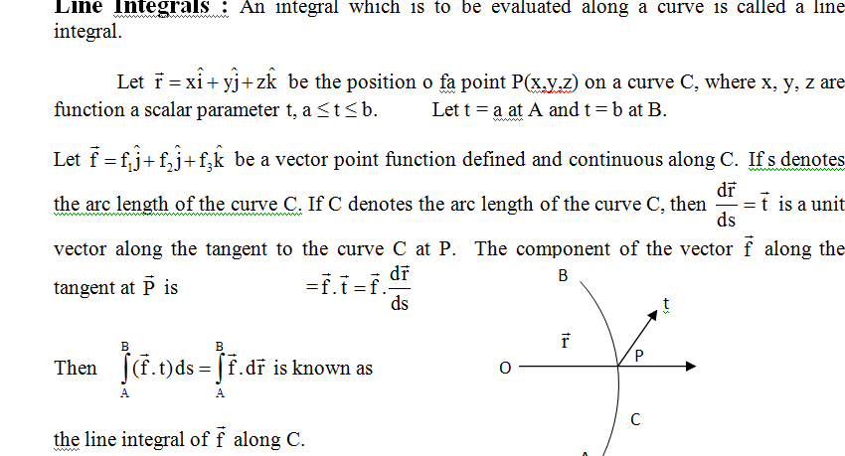
Line integral

Slide 8
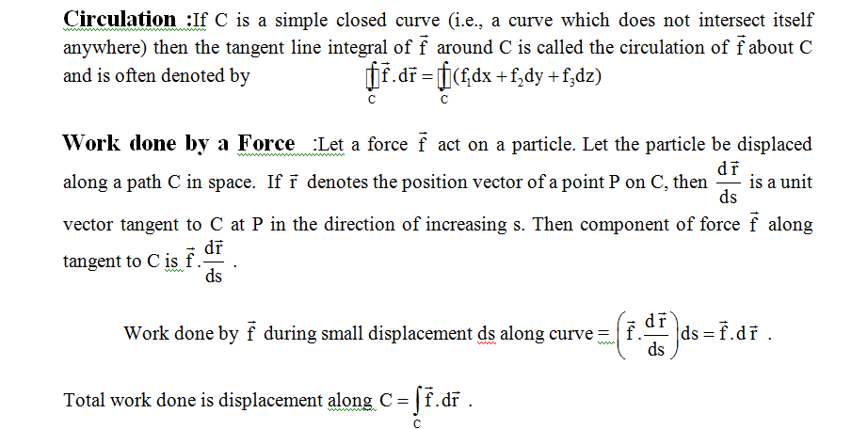
Circulation and Work done by a force

Slide 9
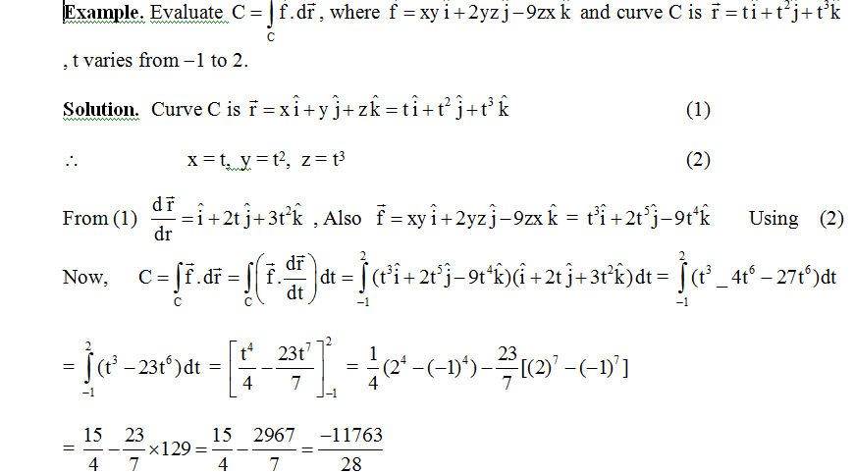

Slide 10
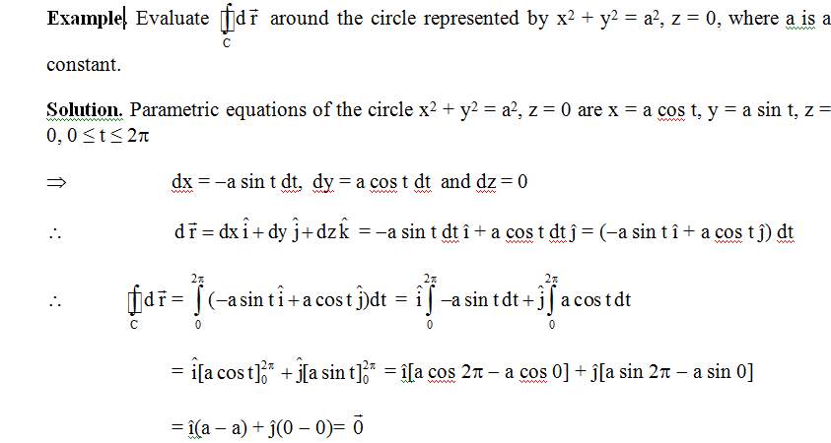

Slide 11
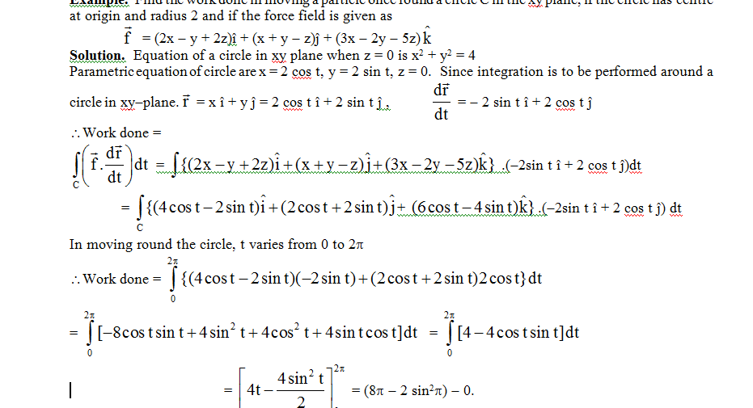

Slide 19
Thank you

